Slide 1
Skin Care Category
Category training document
Document created on : 01.09.2025

Slide 2
Category overview
Skin care category includes products such as applied on skin for moisturizing, conditioning, cleansing products,body powder, sanitizer, liquid and bar soap, bath additive products, sunscreen, tan remover, manual razor, razor blades, shaving cream, after shave and pre shave, hair removal products like solid/liquid wax, hair removal strip
Skin care is defined shortly as that helps to maintain the skin that is used for face and body .

Slide 3
CATEGORY VS COMMODITY GROUPS
CATEGORY | COMMODITY GROUP
SKIN CARE | SHAVING ACCESSORY
SKIN CARE | BATH ADDITIVE AND OIL
SKIN CARE | BLEACHING AND TONING PRODUCT
SKIN CARE | BODY POWDER PRODUCT
SKIN CARE | DEPILATORY PRODUCT
SKIN CARE | SHAVING CREAM AND AFTER SHAVE
SKIN CARE | HAND AND BODY LOTION AND OIL
SKIN CARE | PERSONAL CLEANSER OTHER THAN BAR
SKIN CARE | PERSONAL CLEANSER BAR AND NOVELTY SOAP
SKIN CARE | PETROLEUM JELLY PRODUCT
SKIN CARE | SUN EXPOSURE DETECTOR PRODUCT TOPICAL
SKIN CARE | RAZOR BLADES
SKIN CARE | RAZORS
SKIN CARE | SUNTAN AND AFTER TAN PREPARATION

Slide 4
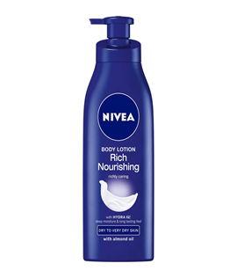

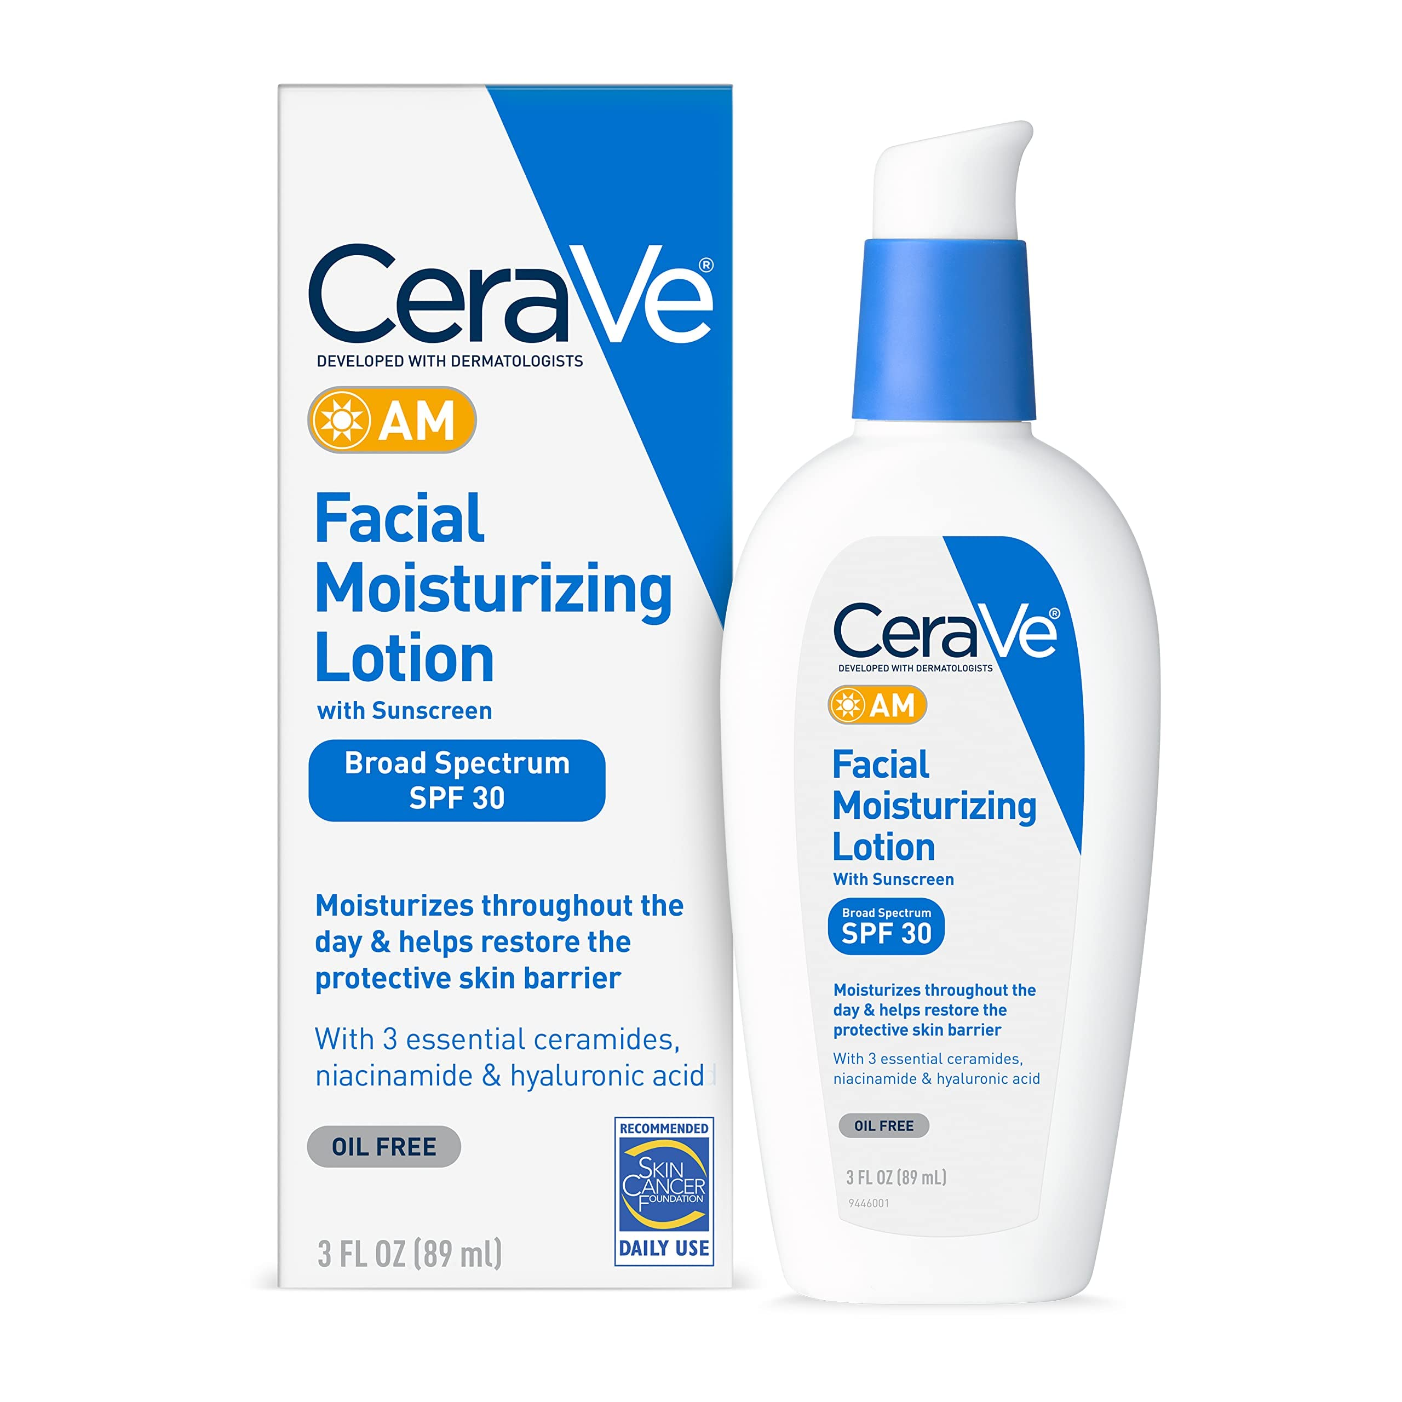
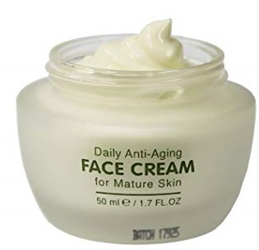
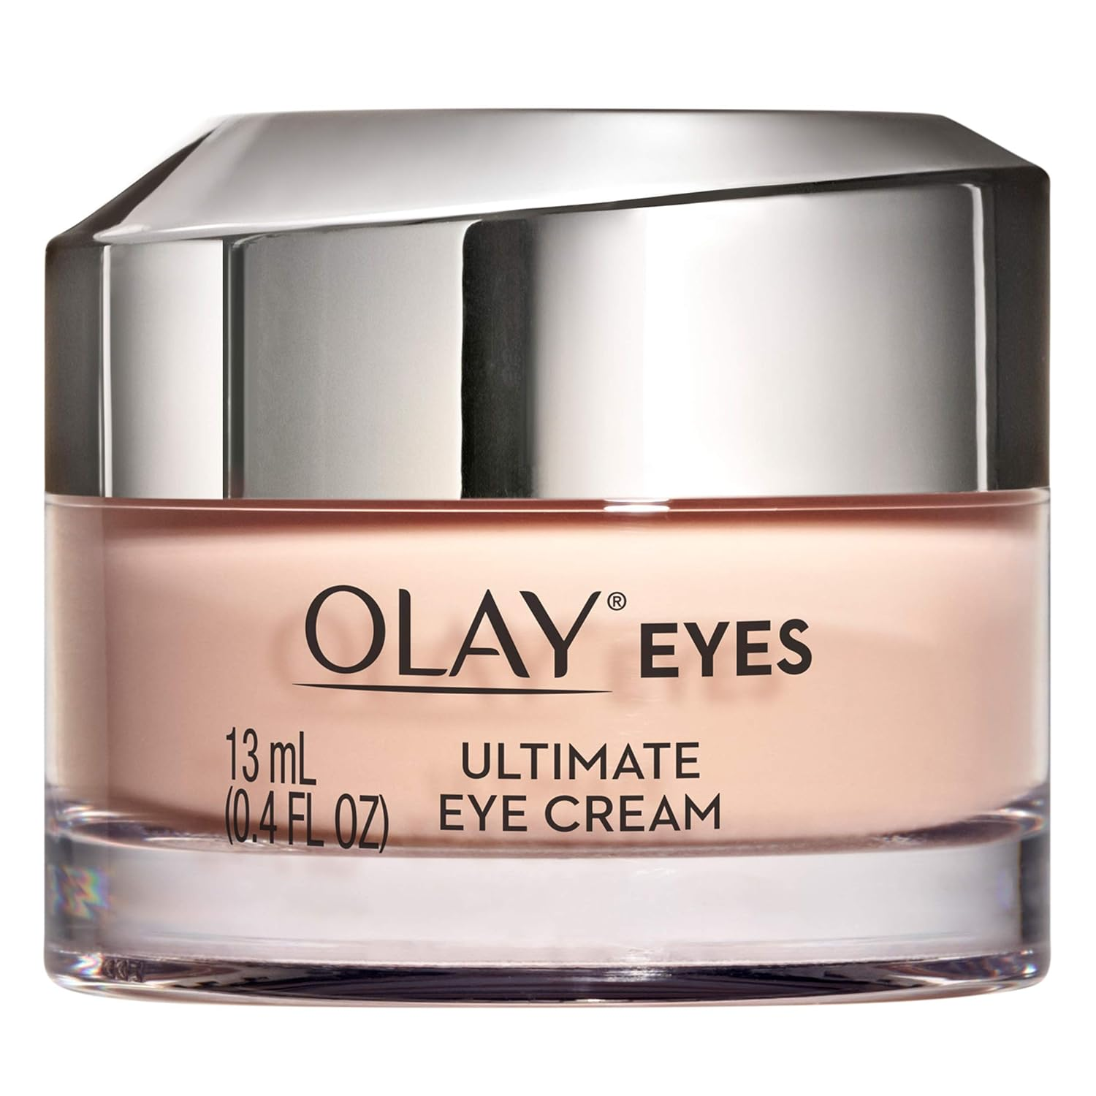
SKIN CARE
Hand And Body Lotion And Oil (Multidose)
Number of Common Consumer Name (CCN) : 311 Default CCN : Hand And Body And Skin Product
Body lotion
Facial cream
Skin serum
Facial Moisturizer
Eye cream

Slide 5
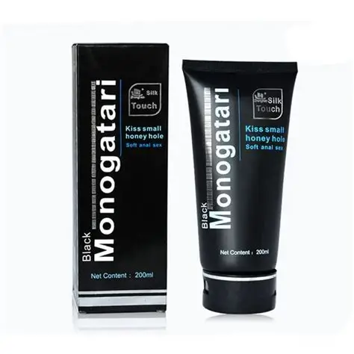
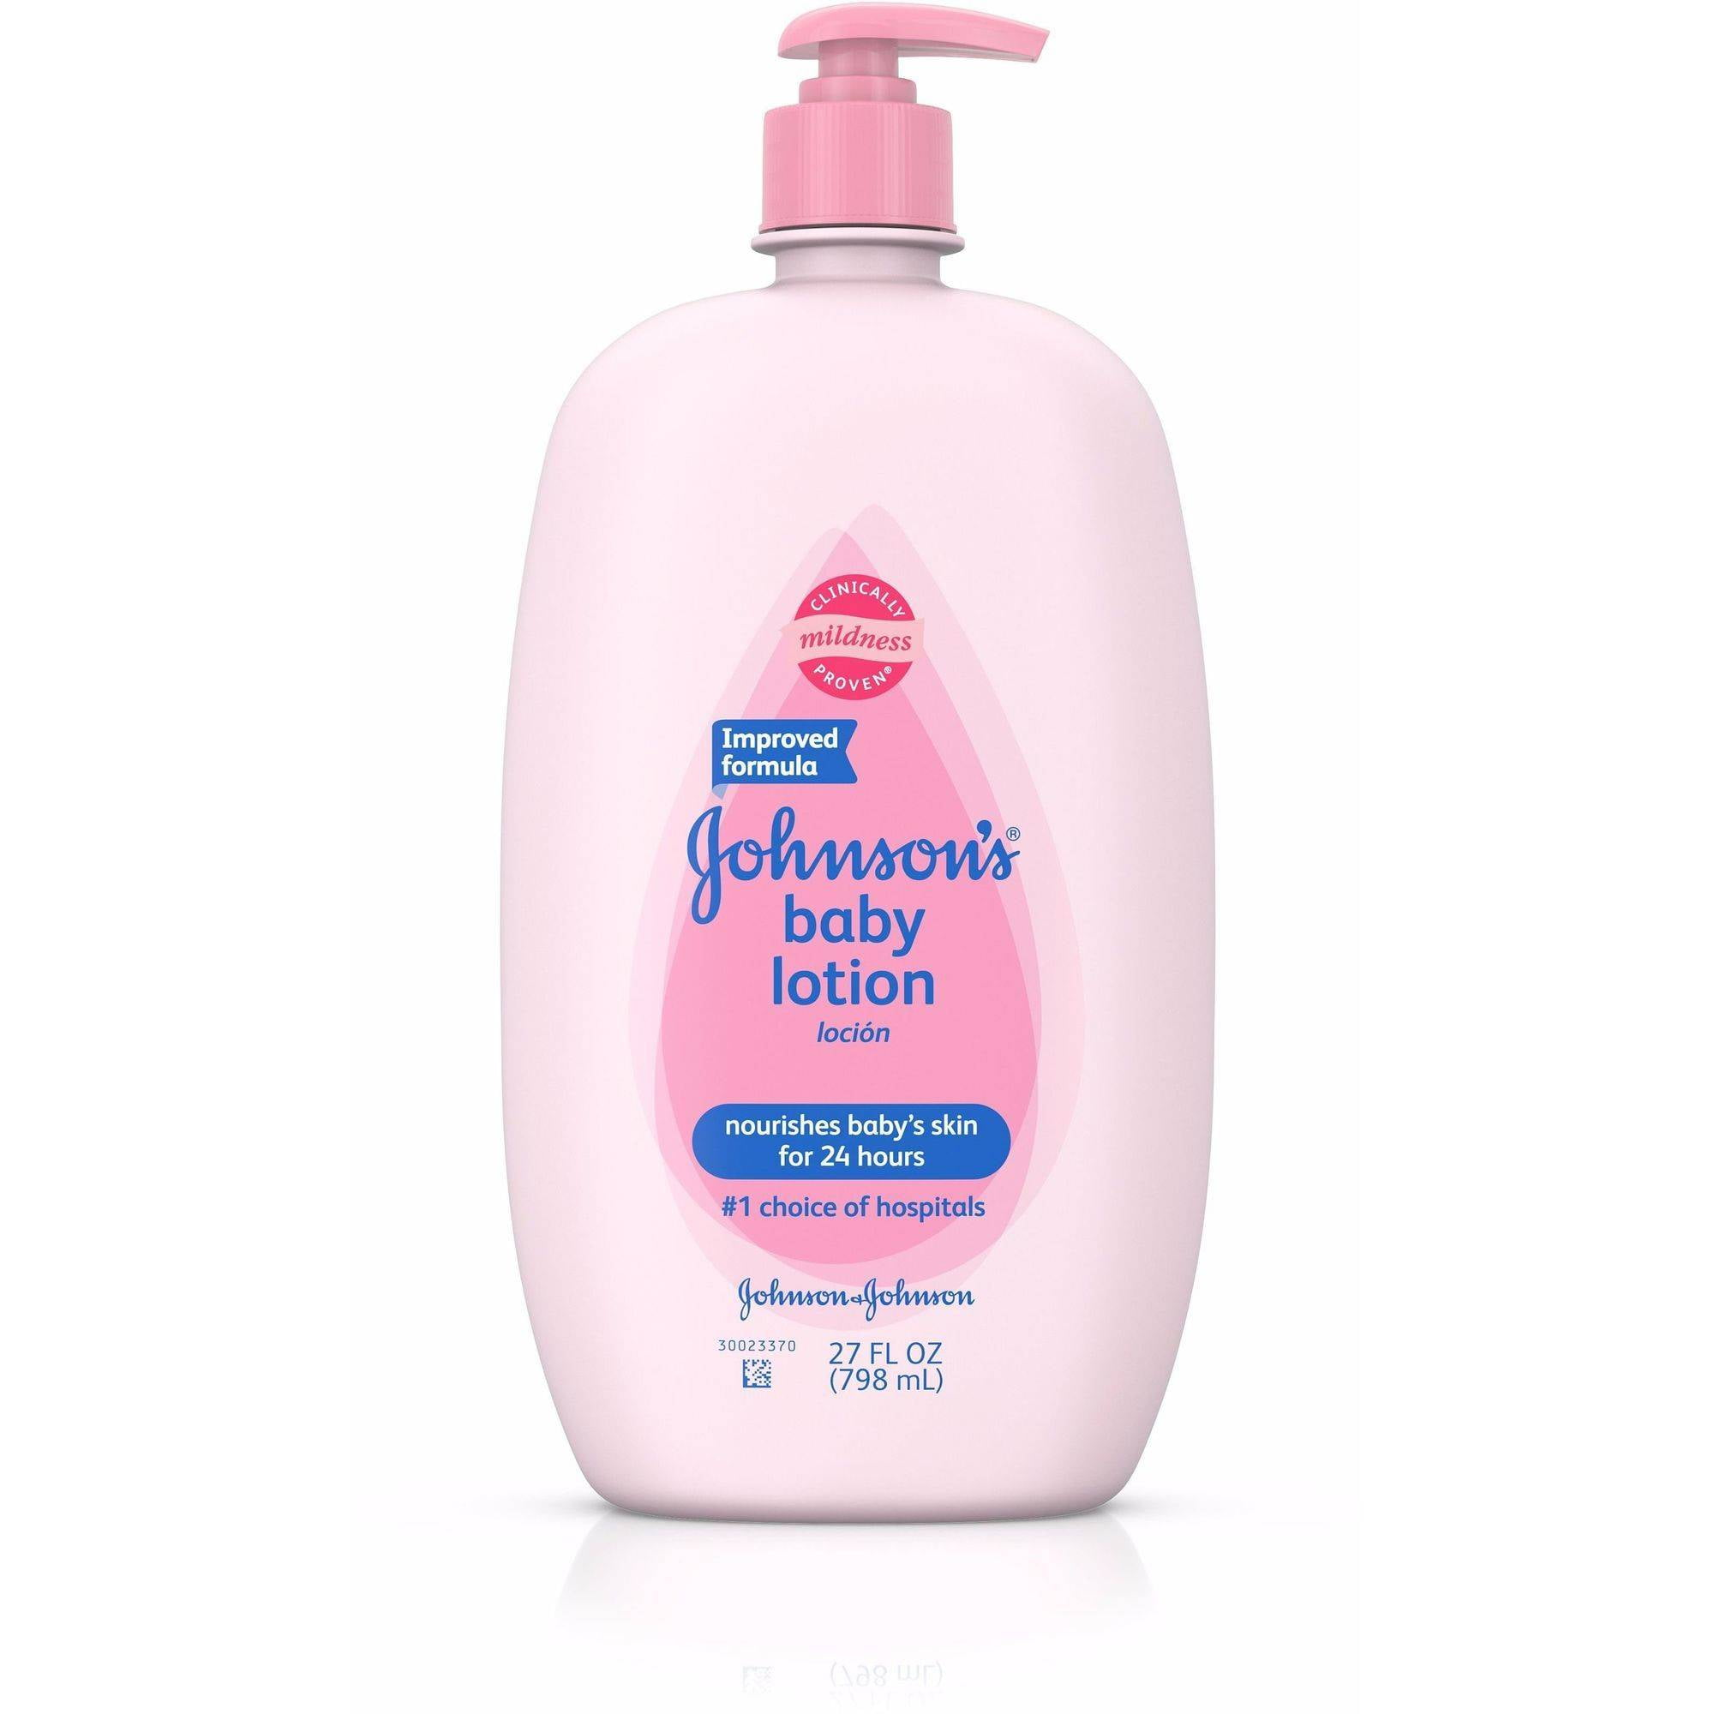
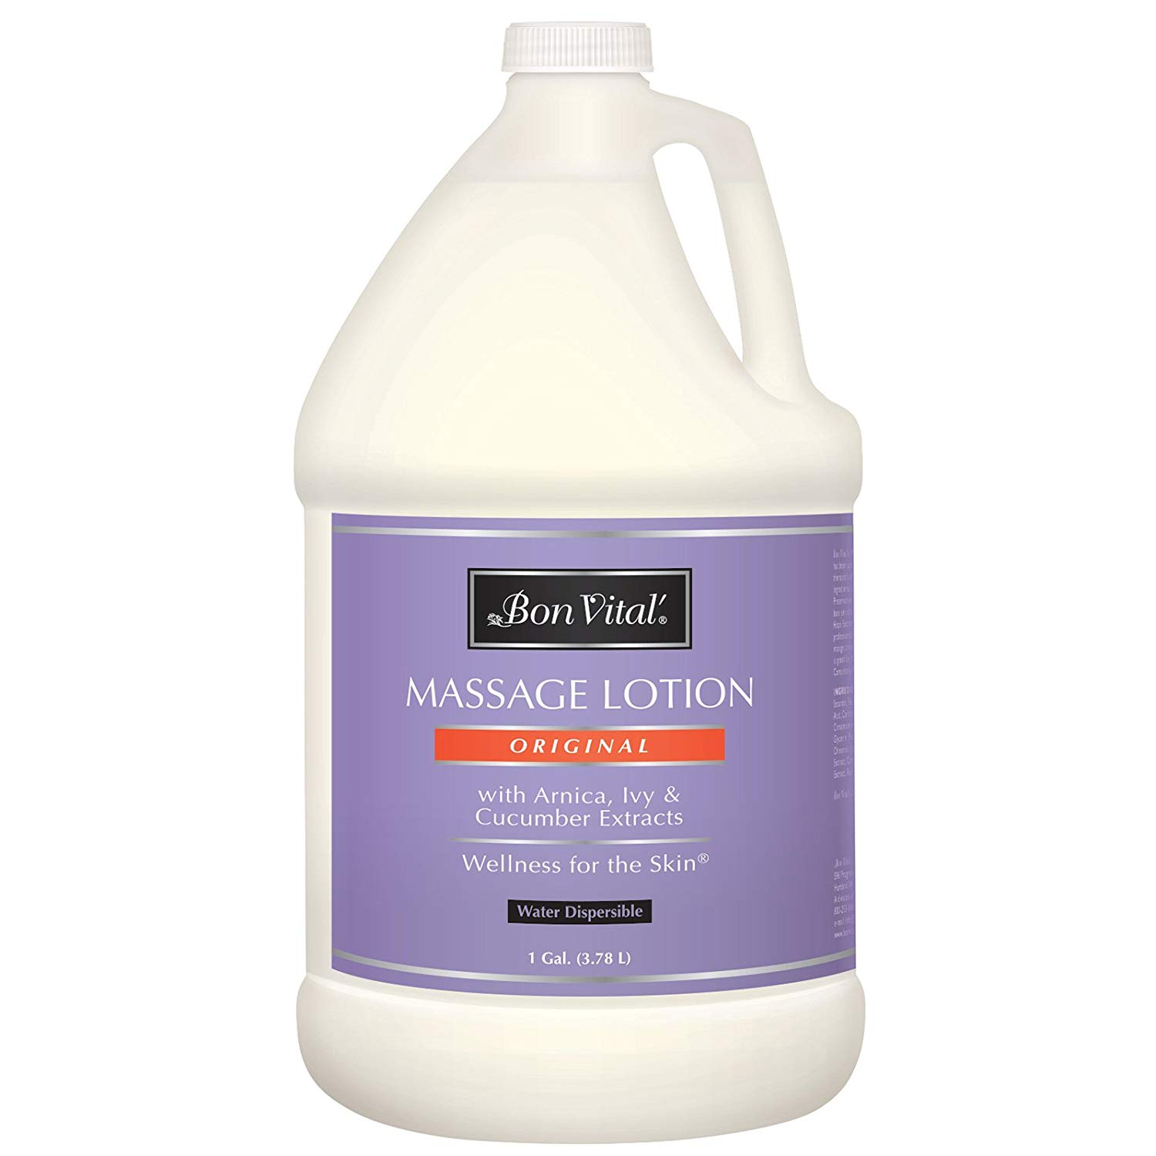
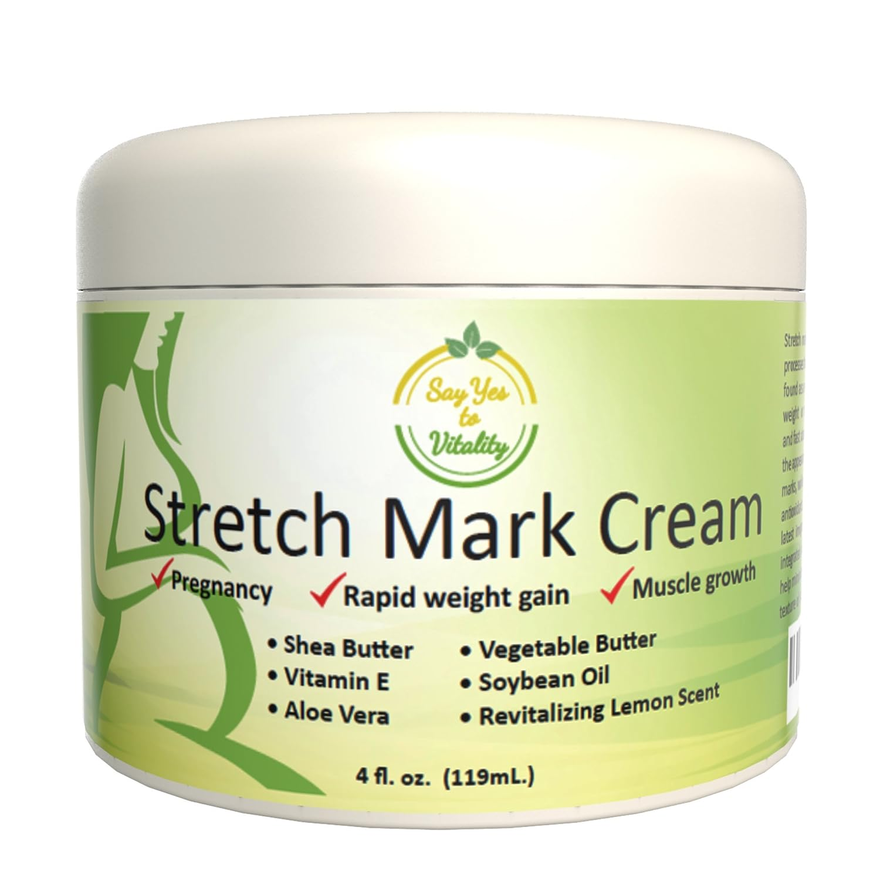
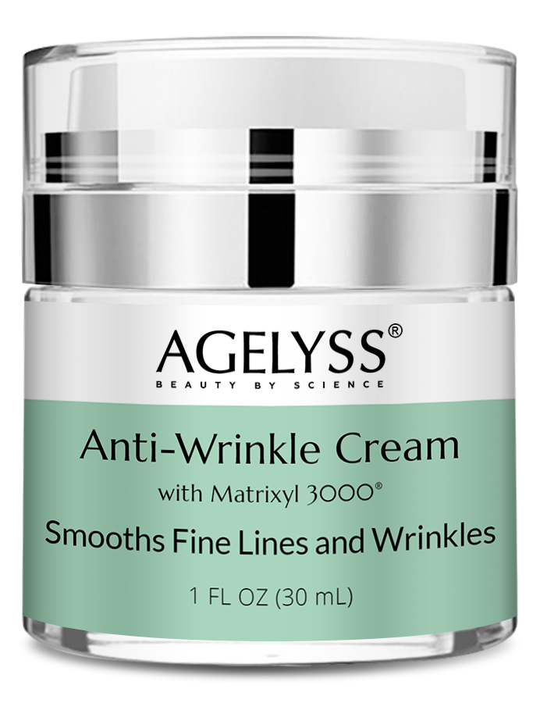
SKIN CARE
Hand And Body Lotion And Oil (Multidose)
Number of Common Consumer Name (CCN) : 311
Stretch mark cream
Antiwrinkle product
Baby Lotion
Massage product
Sexual Enhancer

Slide 6



SKIN CARE
Hand And Body Lotion And Oil (single dose)
Number of Common Consumer Name (CCN) : 311
Night cream
Skin serum
Facial mask
Hand and body and skin product

Slide 7
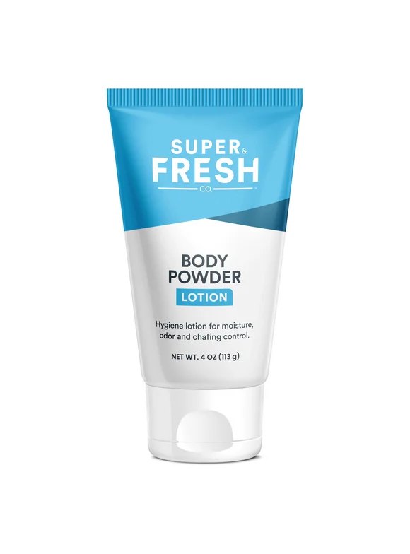

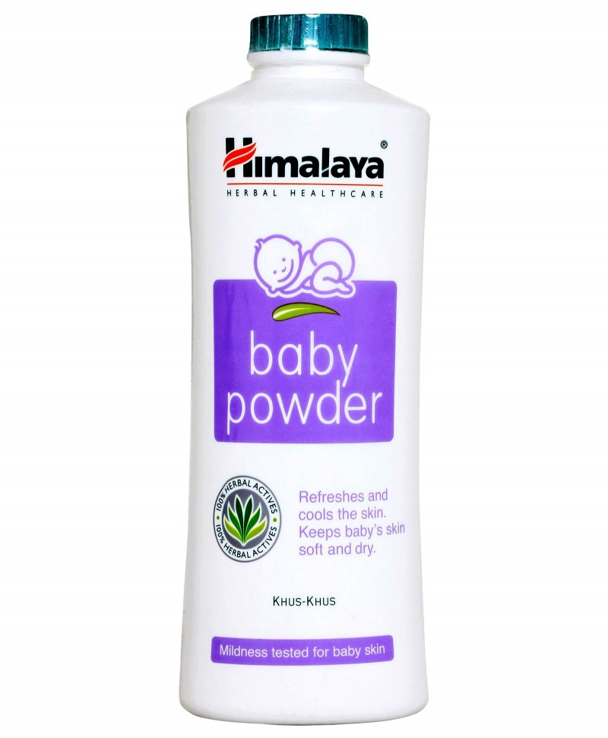
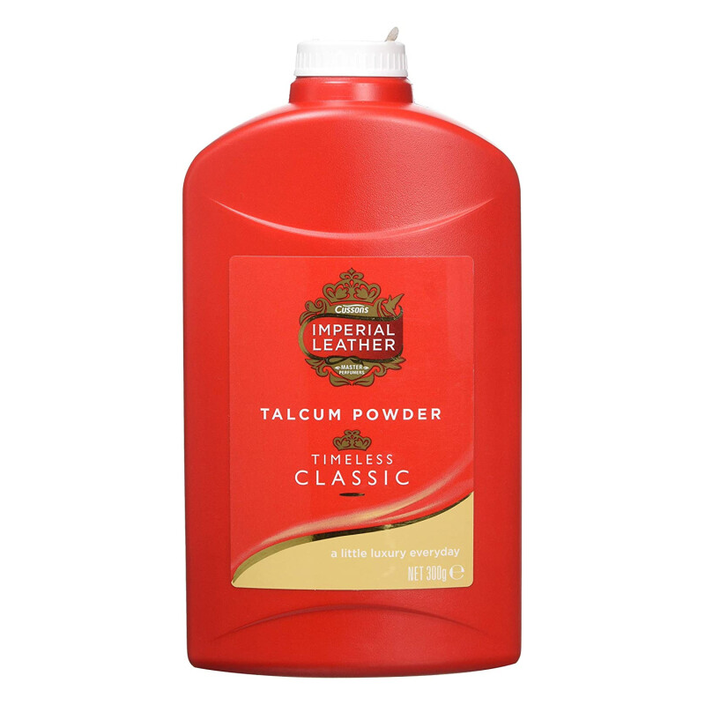
SKIN CARE
Body Powder Product
Number of Common Consumer Name (CCN) : 16
Body powder
Baby powder
Talcum powder
Liquid body powder

Slide 8
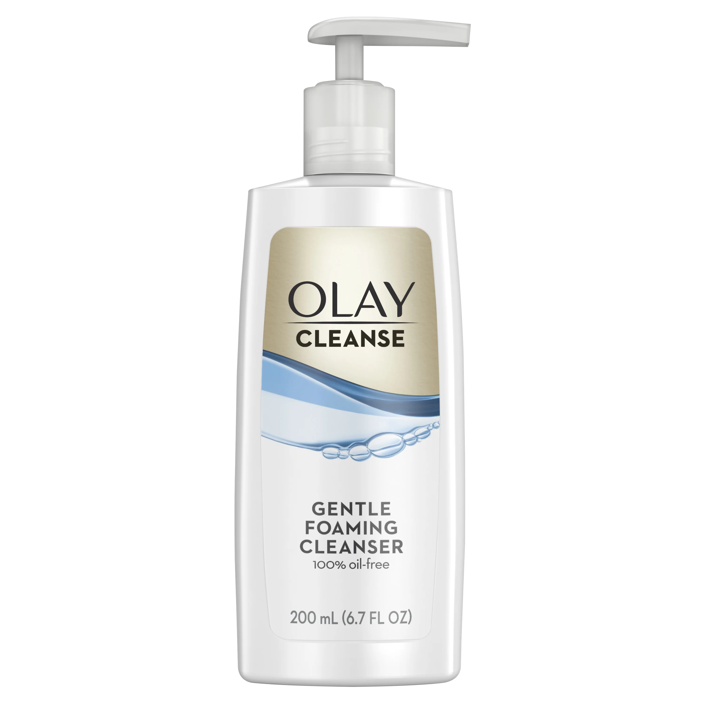
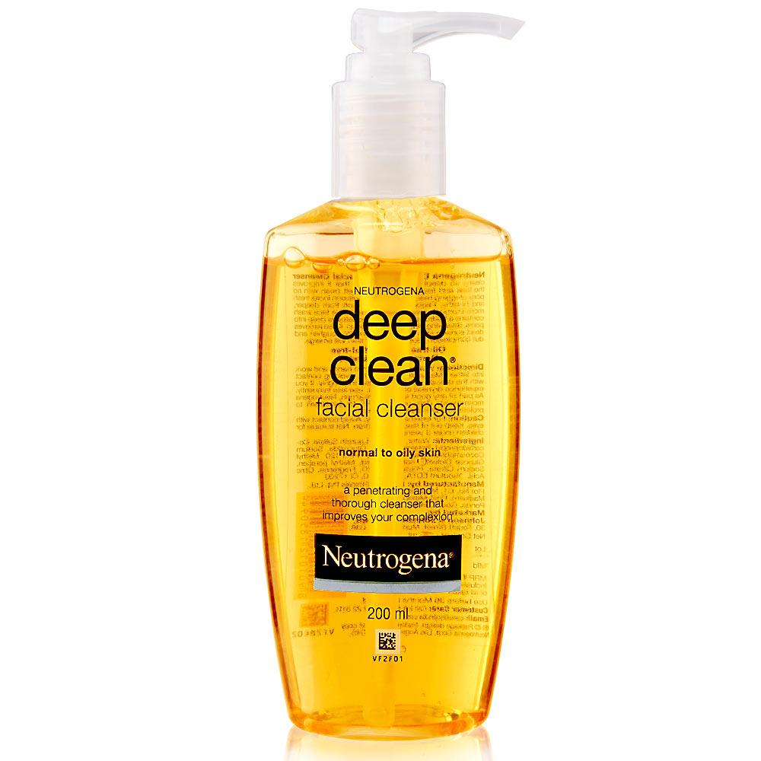
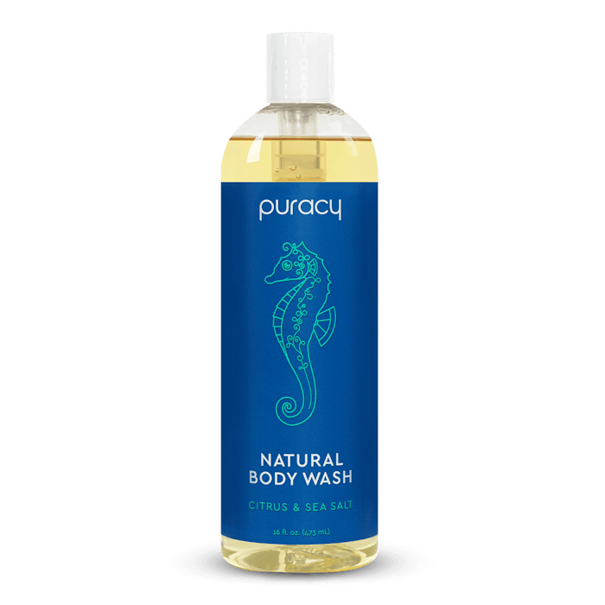
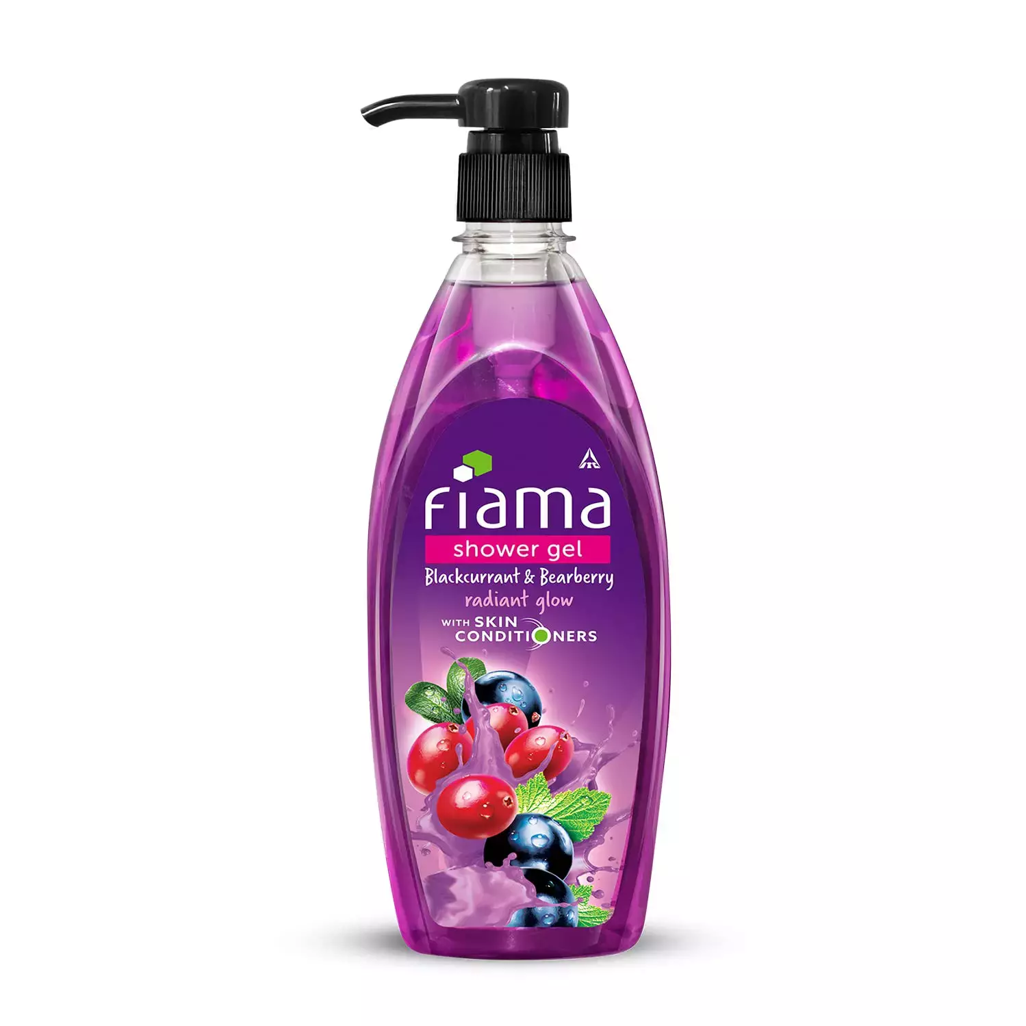
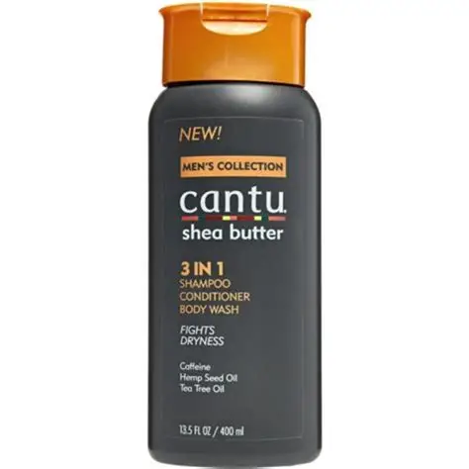
SKIN CARE
Personal Cleanser Other Than Bar
Number of Common Consumer Name (CCN) : 187
Default CCN : Skin cleanser, Skin wash
Skin cleanser
Facial cleanser
Body wash
Shower soap
Shampoo and conditioner and body wash

Slide 9
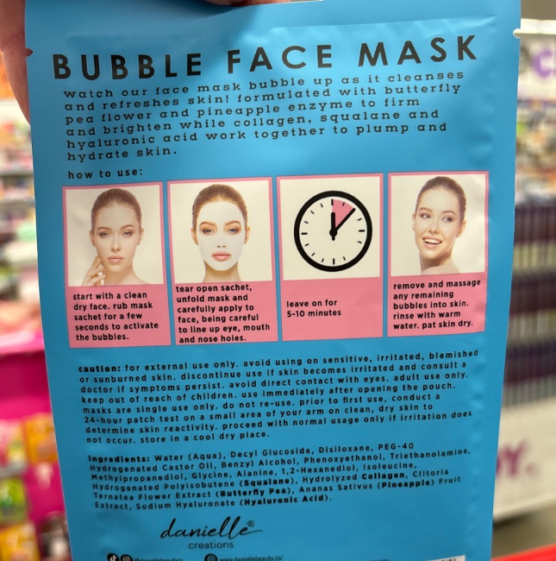
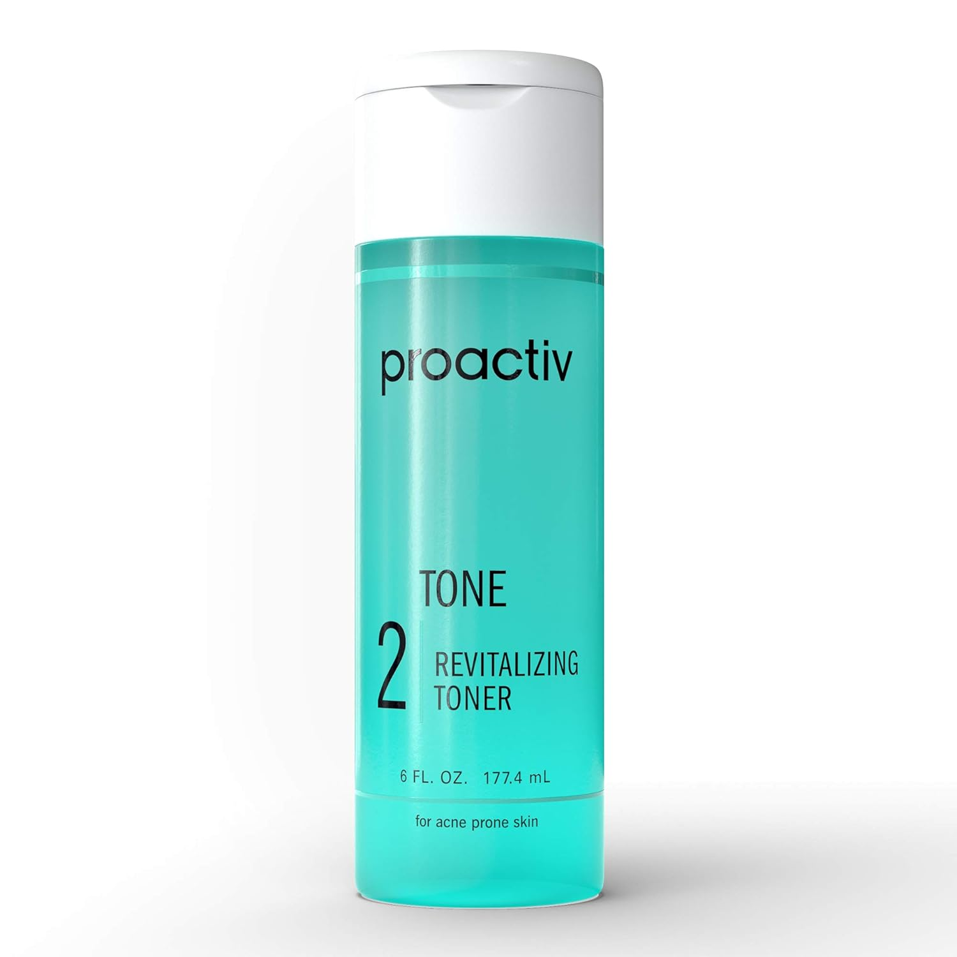
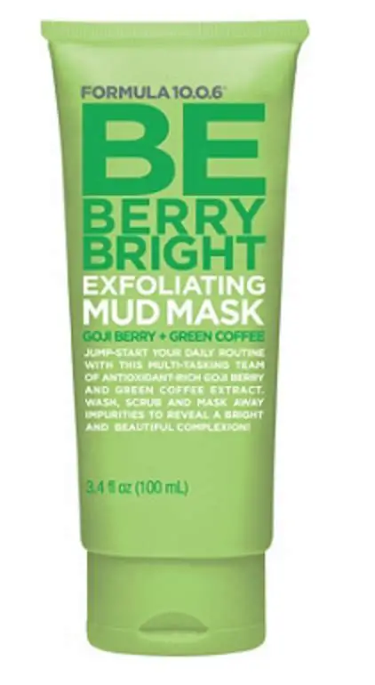
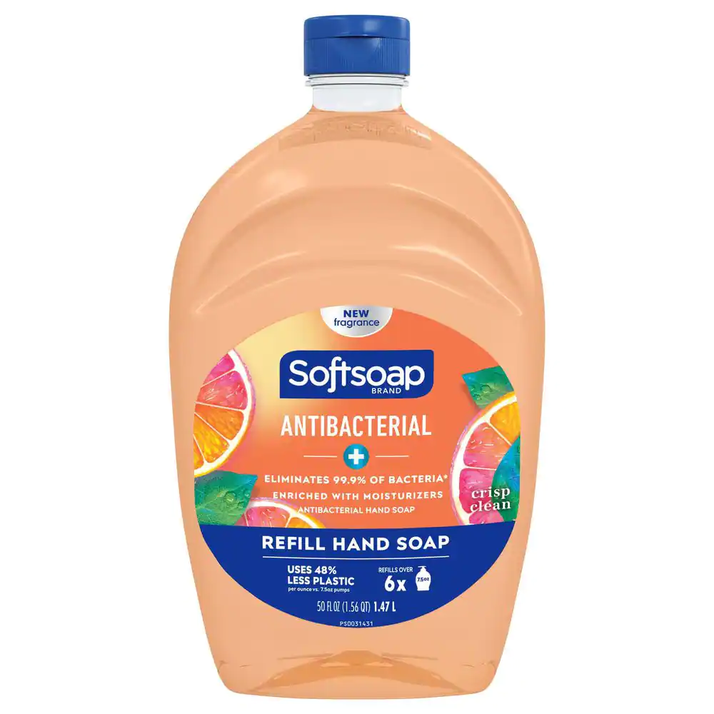
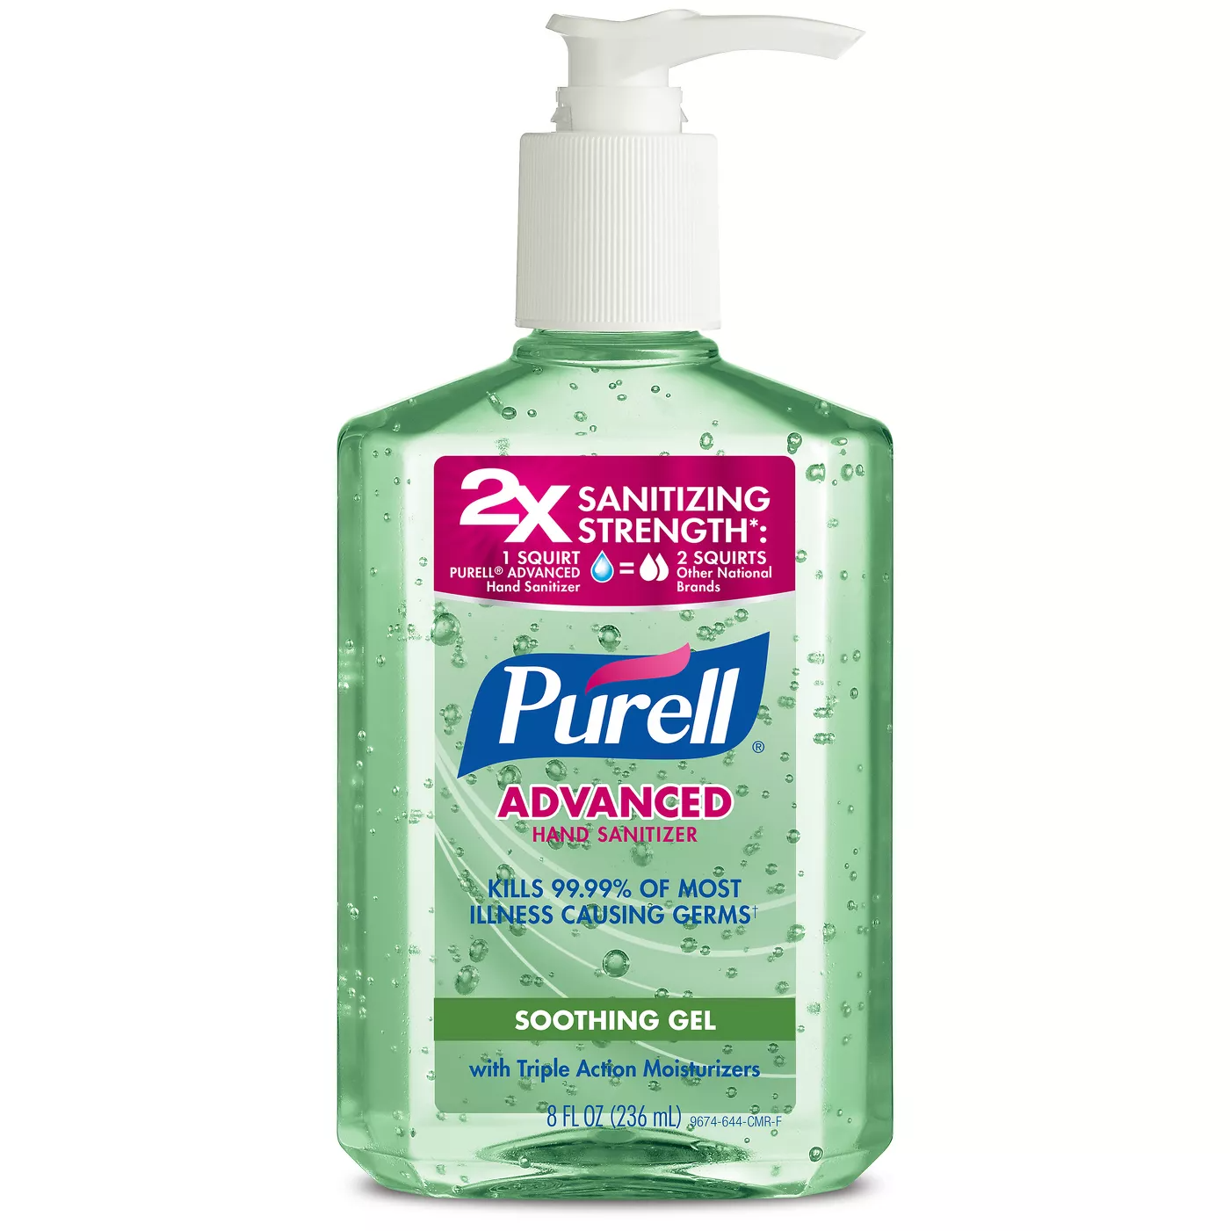
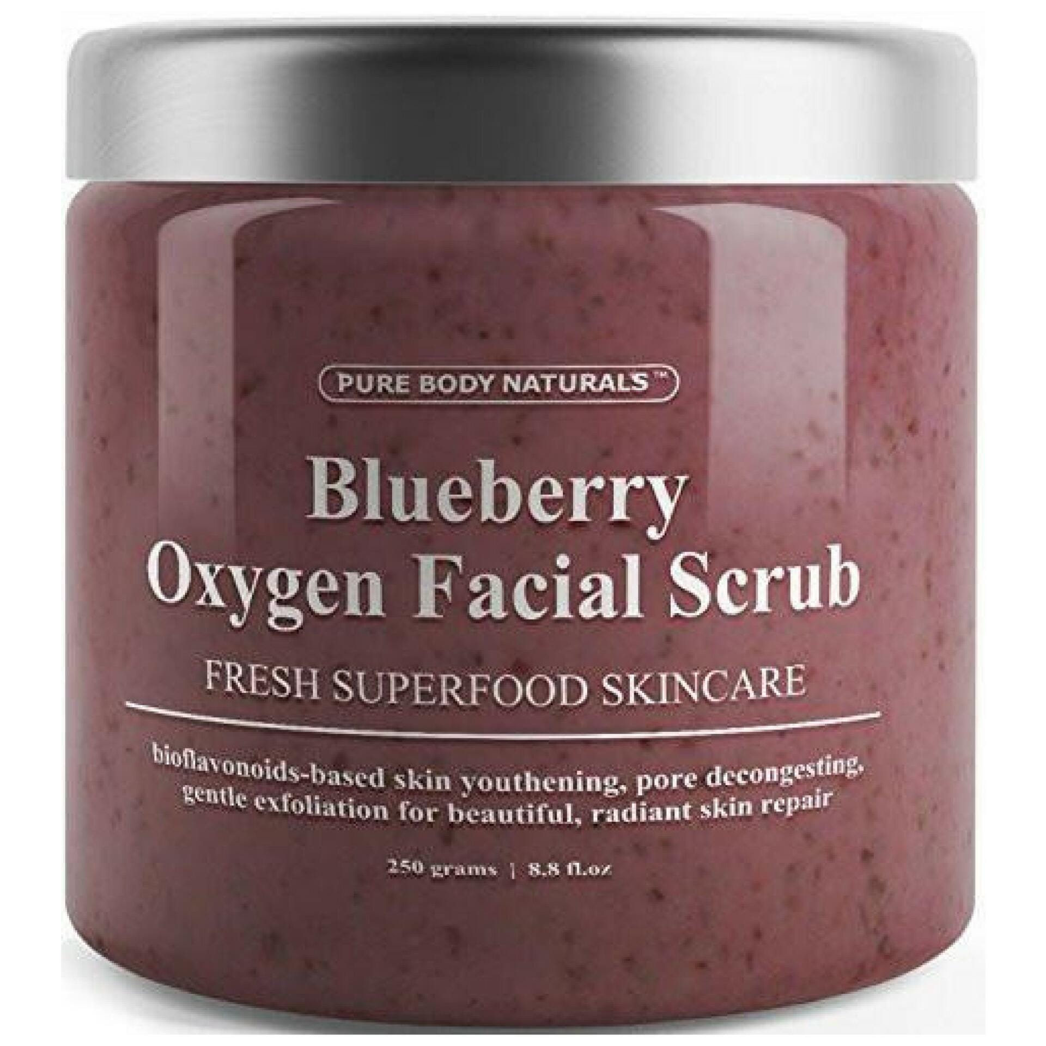
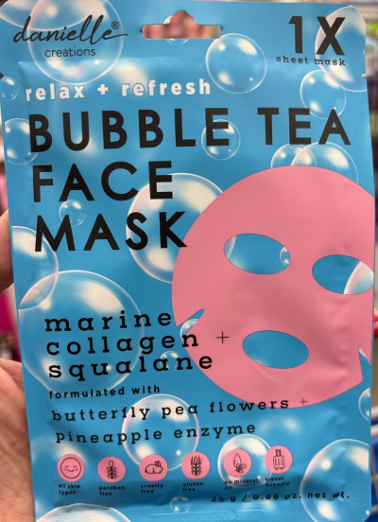
SKIN CARE
Personal Cleanser Other Than Bar
Number of Common Consumer Name (CCN) : 187
Hand soap Refill
Hand sanitizer
Skin toner
Facial scrub
Skin mask
Facial mask

Slide 10
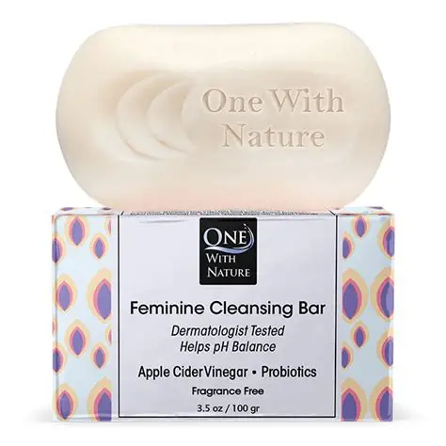
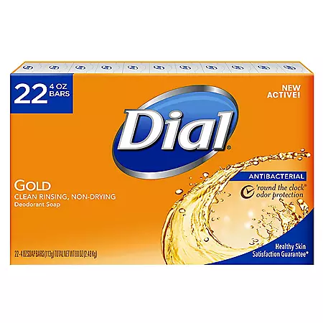
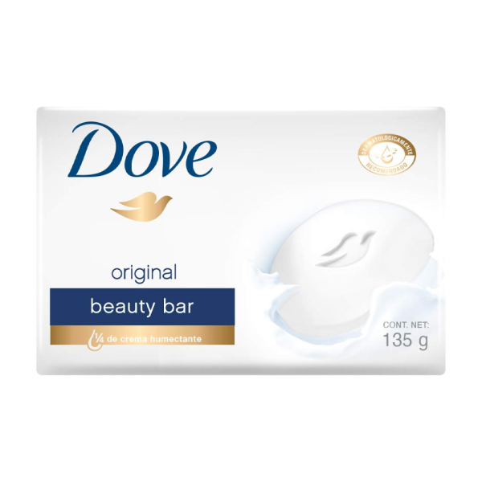
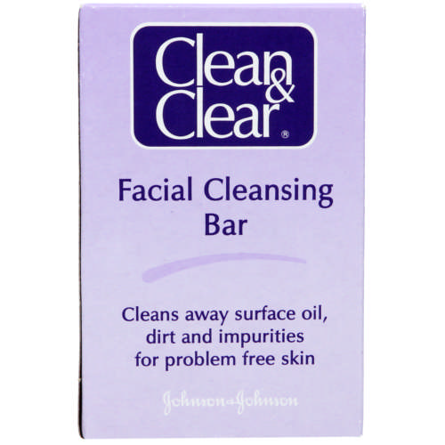
SKIN CARE
Personal Cleanser Bar And Novelty Soap
Number of Common Consumer Name (CCN) : 17
Bar soap
Cleansing bar soap
Beauty bar soap
Feminine bar soap

Slide 11
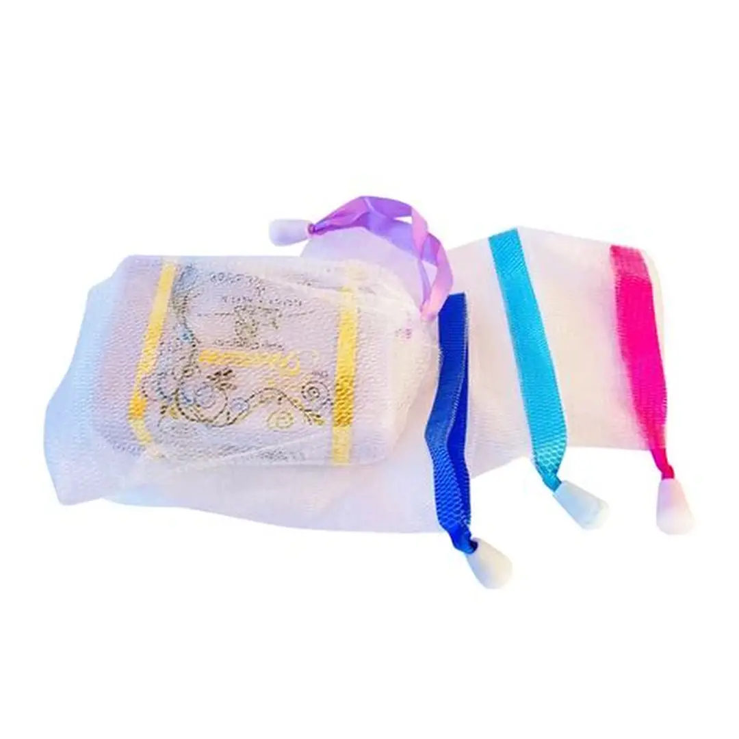
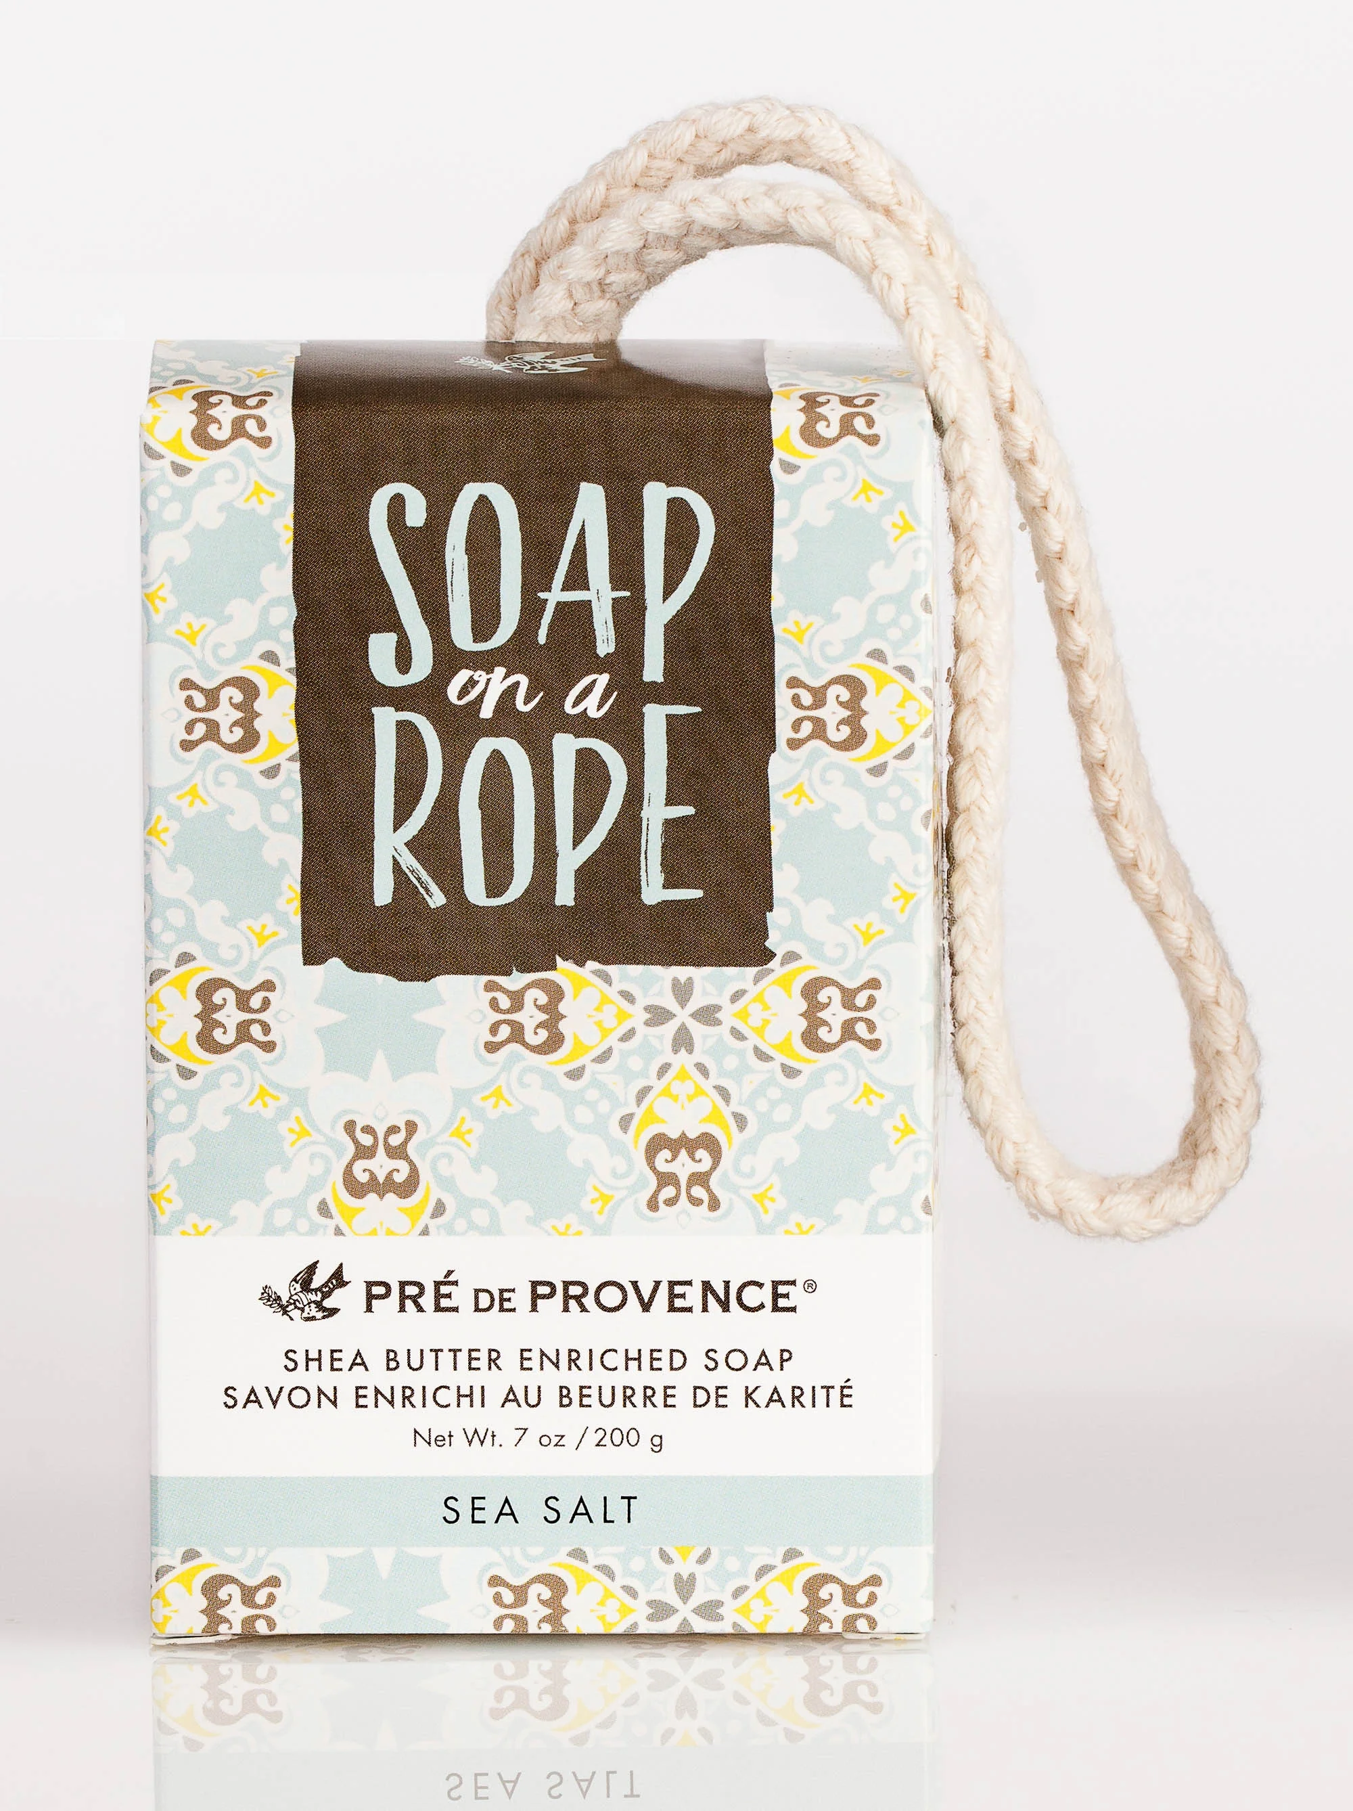
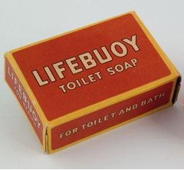
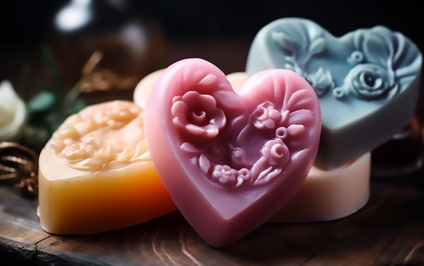
SKIN CARE
Personal Cleanser Bar And Novelty Soap
Number of Common Consumer Name (CCN) : 17
Bar soap with pouch
Toilet soap
Novelty soap
Bar soap on a rope

Slide 12

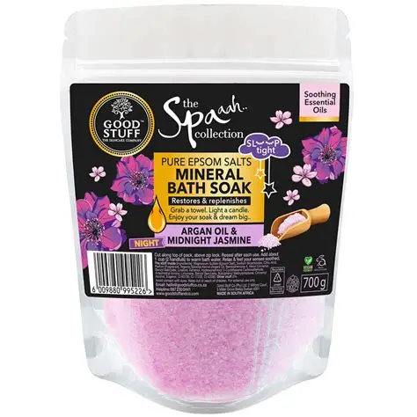


SKIN CARE
Bath Additive And Oil
Number of Common Consumer Name (CCN) : 48
Bath product
Mineral Bath soak
Bath seltzer
Bubble bath

Slide 13
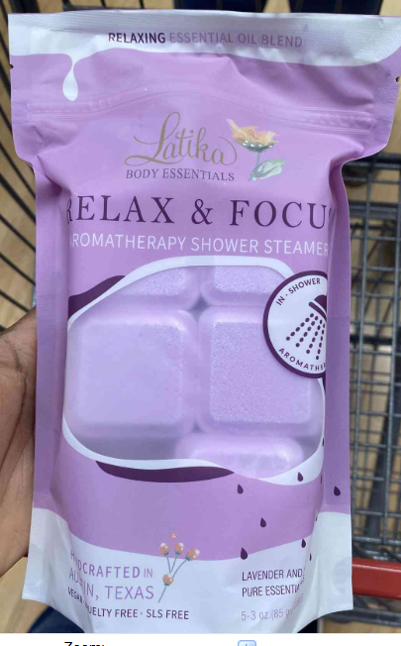
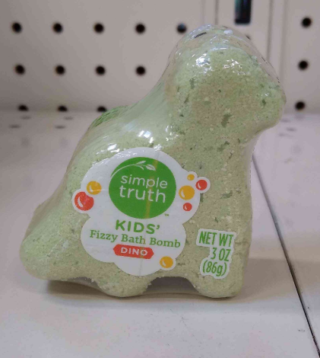

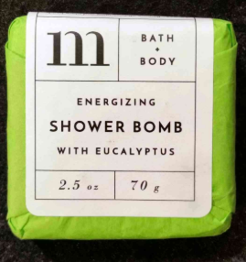
SKIN CARE
Bath Additive And Oil
Number of Common Consumer Name (CCN) : 48
Aromatherapy bath product
Bath fizz bomb
Bath product (form-bomb)
Bath and shower product

Slide 14
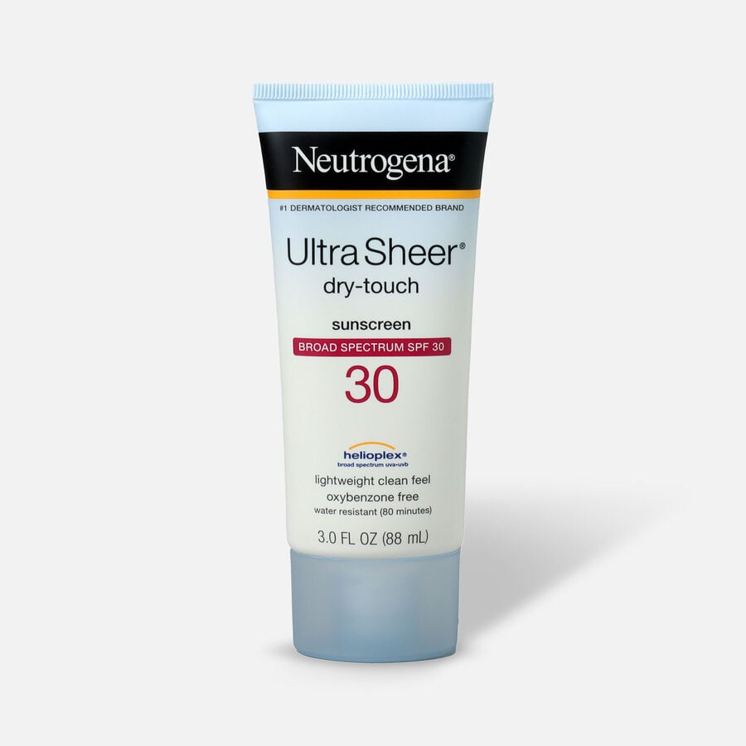
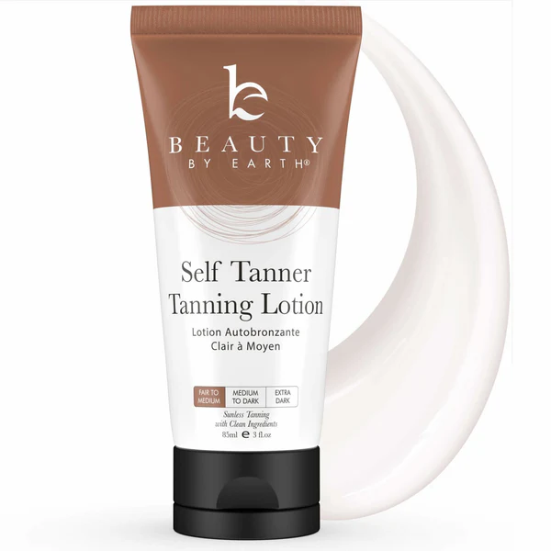
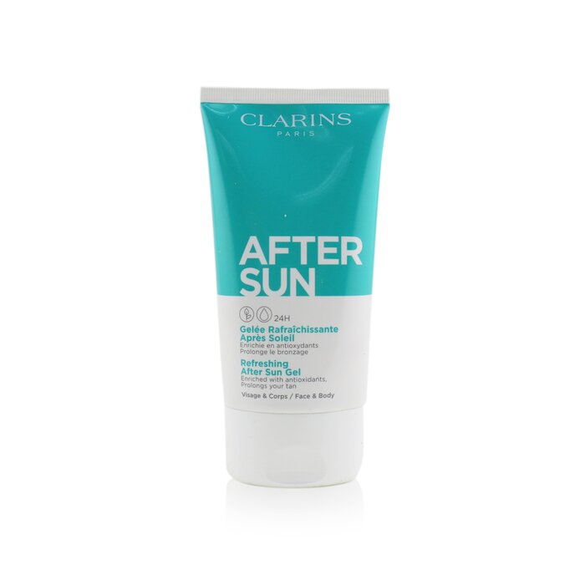
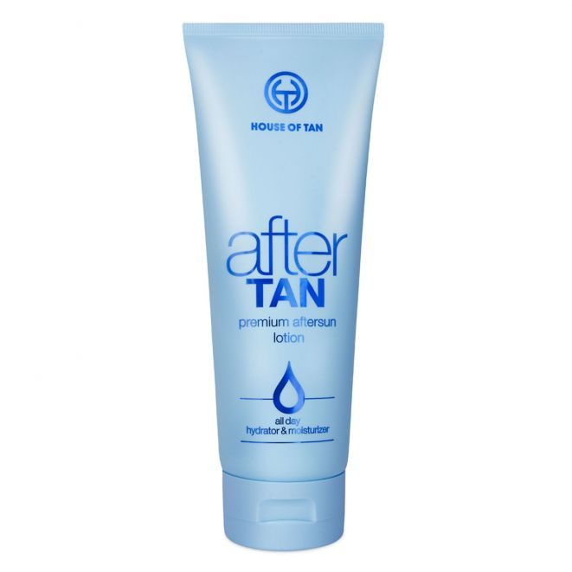
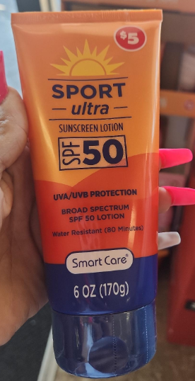
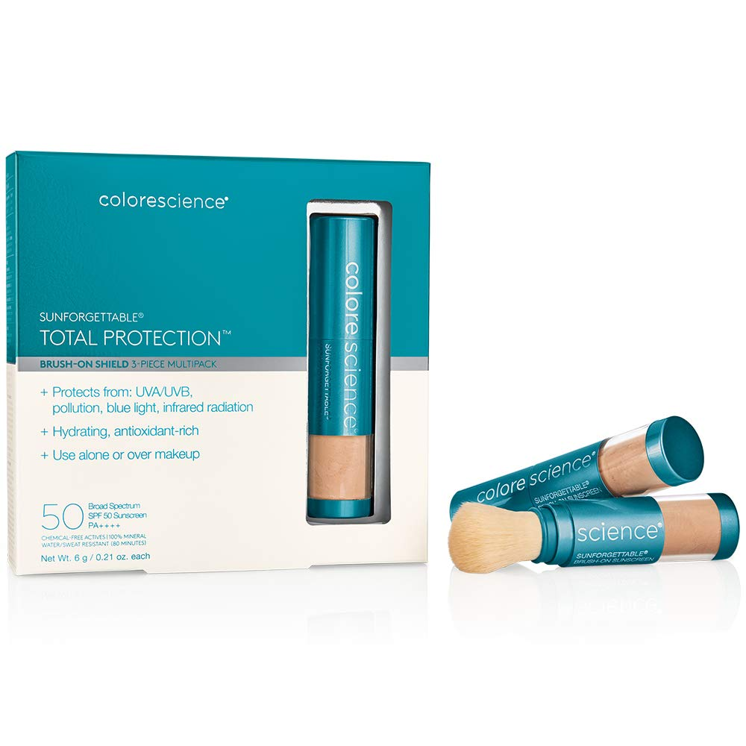
SKIN CARE
Suntan And After Tan Preparation
Number of Common Consumer Name (CCN) : 85
Sunscreen
Self tanner
After sun product
After tan product
Sport suncreen
Sunscreen

Slide 15
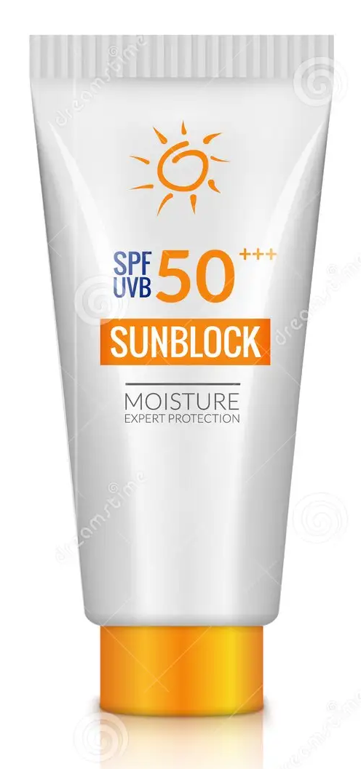
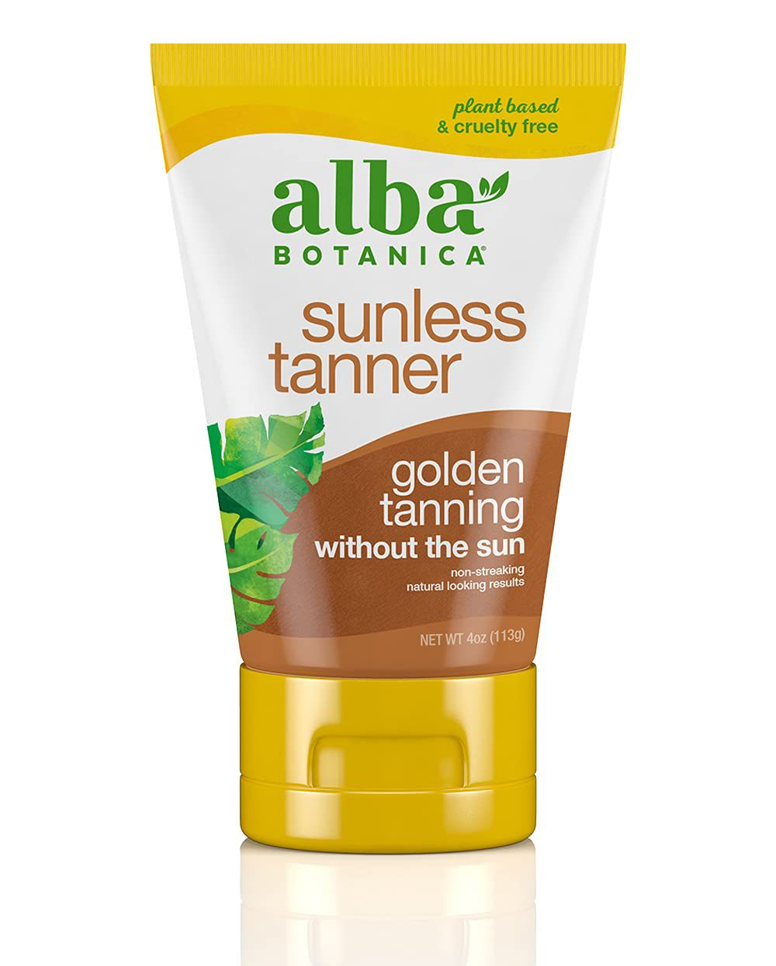
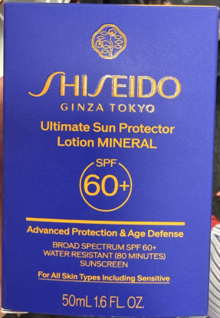
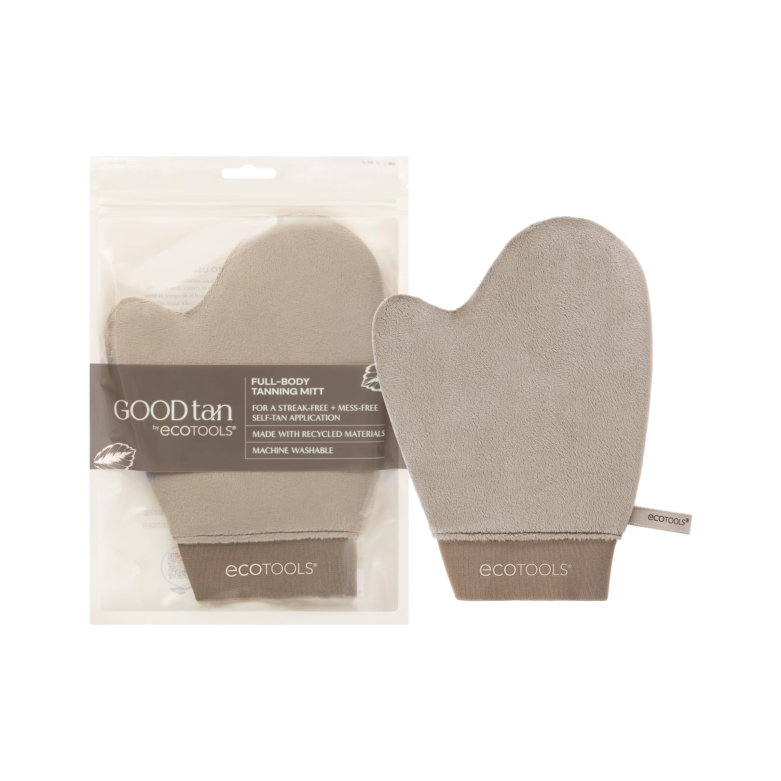
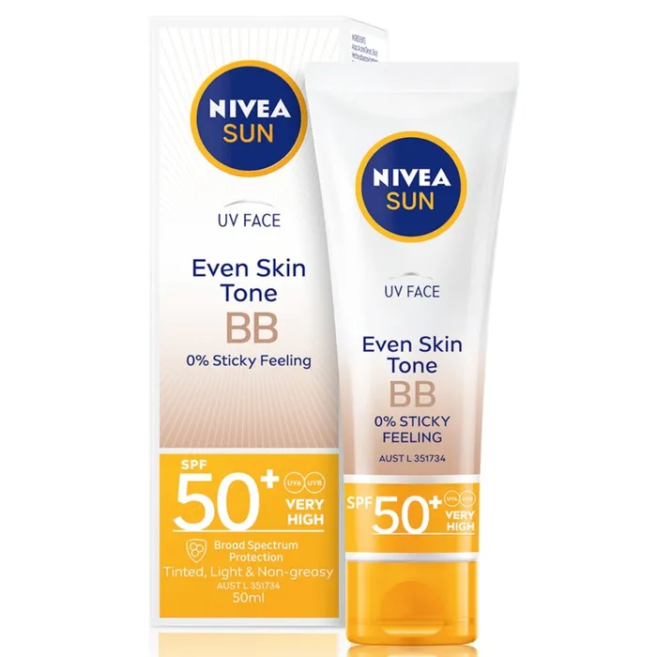
SKIN CARE
Suntan And After Tan Preparation
Number of Common Consumer Name (CCN) : 85
Sun protector
Sun block
Sunless tanner
Self tanning product
BB sunscreen

Slide 16
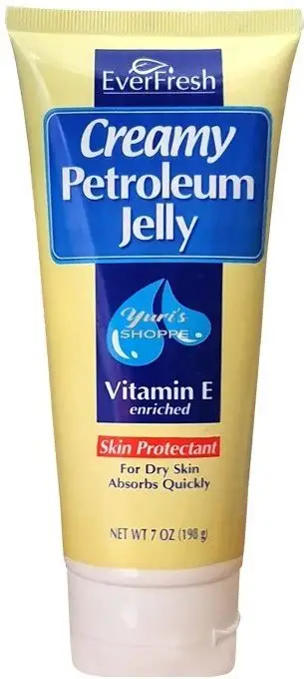
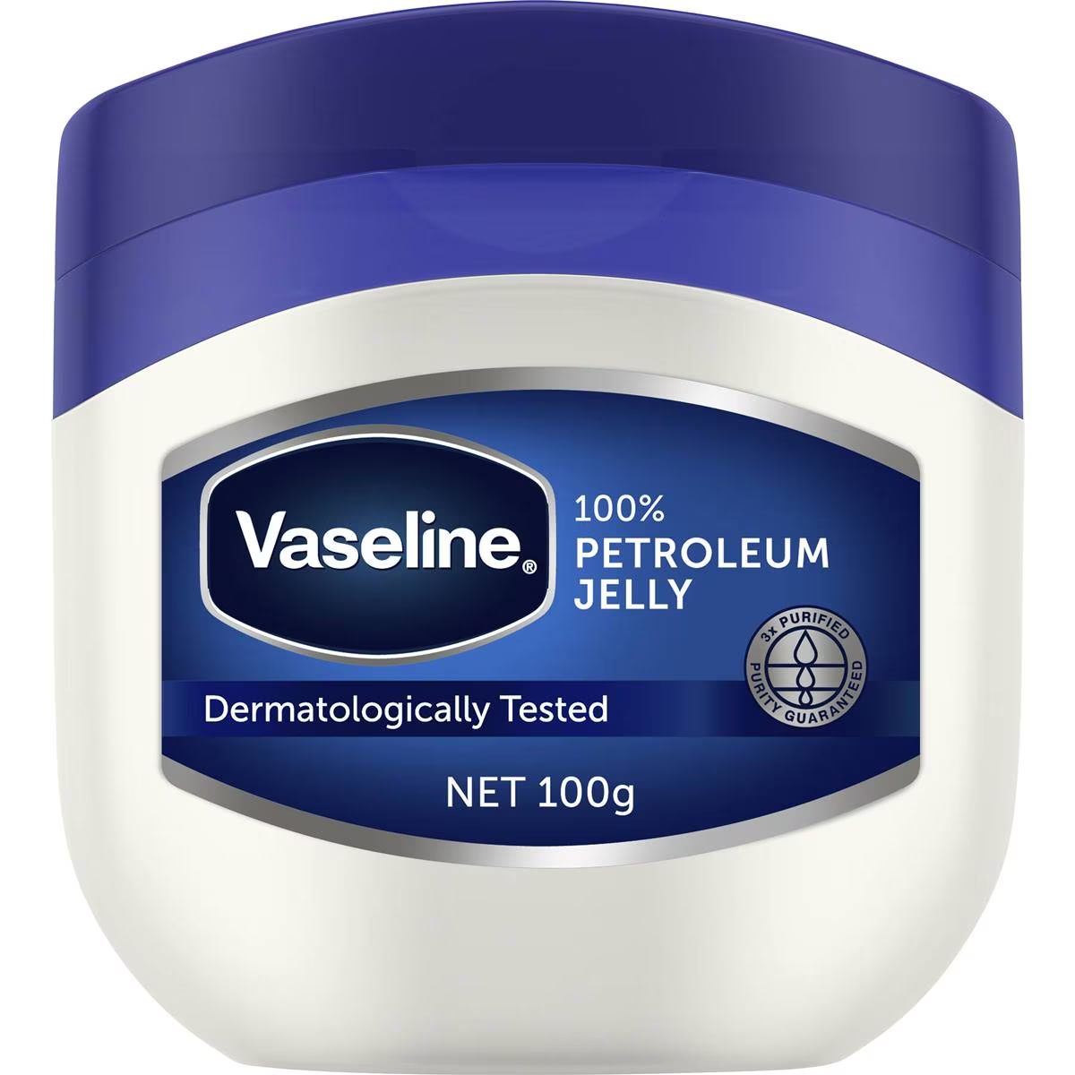
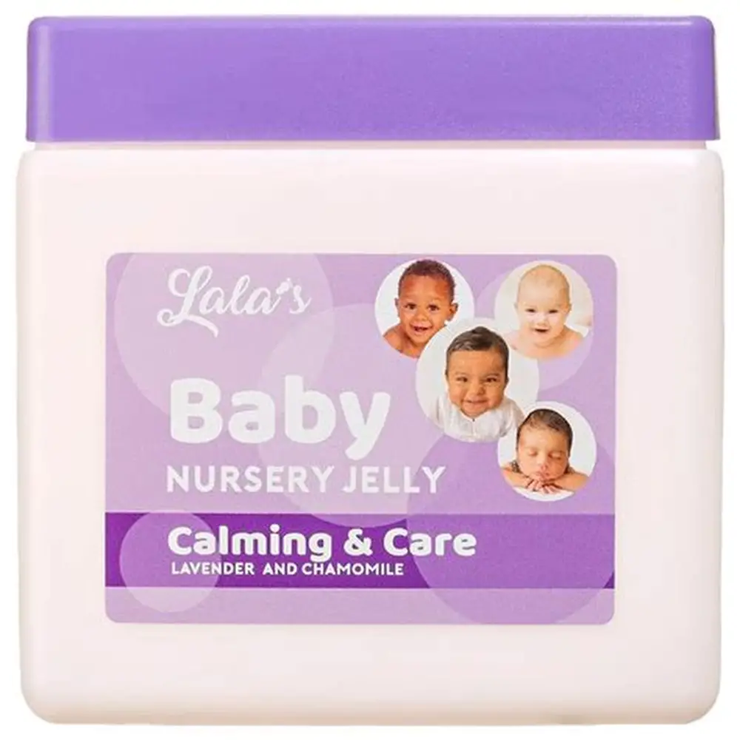
SKIN CARE
Pertroleum Jelly
Number of Common Consumer Name (CCN) : 3
Petroleum jelly
Creamy petroleum jelly
Nursery jelly

Slide 17






SKIN CARE
Bleaching And Toning Product
Number of Common Consumer Name (CCN) : 17
Skin bleaching
treatment
Body hair bleach
Body hair bleach activator
Skin whitener
Skin lightener
Skin bleach
Skin tone

Slide 18






SKIN CARE
Shaving Cream And After Shave
Number of Common Consumer Name (CCN) : 60
Shave cream
Shaving gel
Shave butter
Shaving soap
Shaving bar
Shave oil

Slide 19





SKIN CARE
Shaving Cream And After Shave
Number of Common Consumer Name (CCN) : 60
Preshave
Preshave scrub
Post shave
After shave
After shave splash on

Slide 20





SKIN CARE
Shaving Cream And After Shave
Number of Common Consumer Name (CCN) : 60
Anti bump lotion
Razor bump and ingrown hair product
Pre epilator
Razor bump treatment
Shaveburn relief

Slide 21





SKIN CARE
Razors
Number of Common Consumer Name (CCN) : 6
CCN - Razor Type - Nondisposable
Razor with one
catridge
CCN - Razor Type - disposable
CCN - Razor Type - cut throat & single/double edge
CCN - Razor Type - cut throat & single/double edge

Slide 22



SKIN CARE
Razor Blades
Number of Common Consumer Name (CCN) : 4
Razor Blade
Razor Blade
Injector Razor Blade

Slide 23





SKIN CARE
Shaving Accessory
Number of Common Consumer Name (CCN) : 32
Razor case
Razor + Razor holder + shaving brush
Shave bowl
Shaving template
Styptic pencil

Slide 24





SKIN CARE
Depilatory Product
Number of Common Consumer Name (CCN) : 11
Depilatory
Hair removal
product
Hair remover wax strip kit
Hair removal kit
Microwave hair removal kit

